Slide 1


One Parent Families Scotland

Slide 2
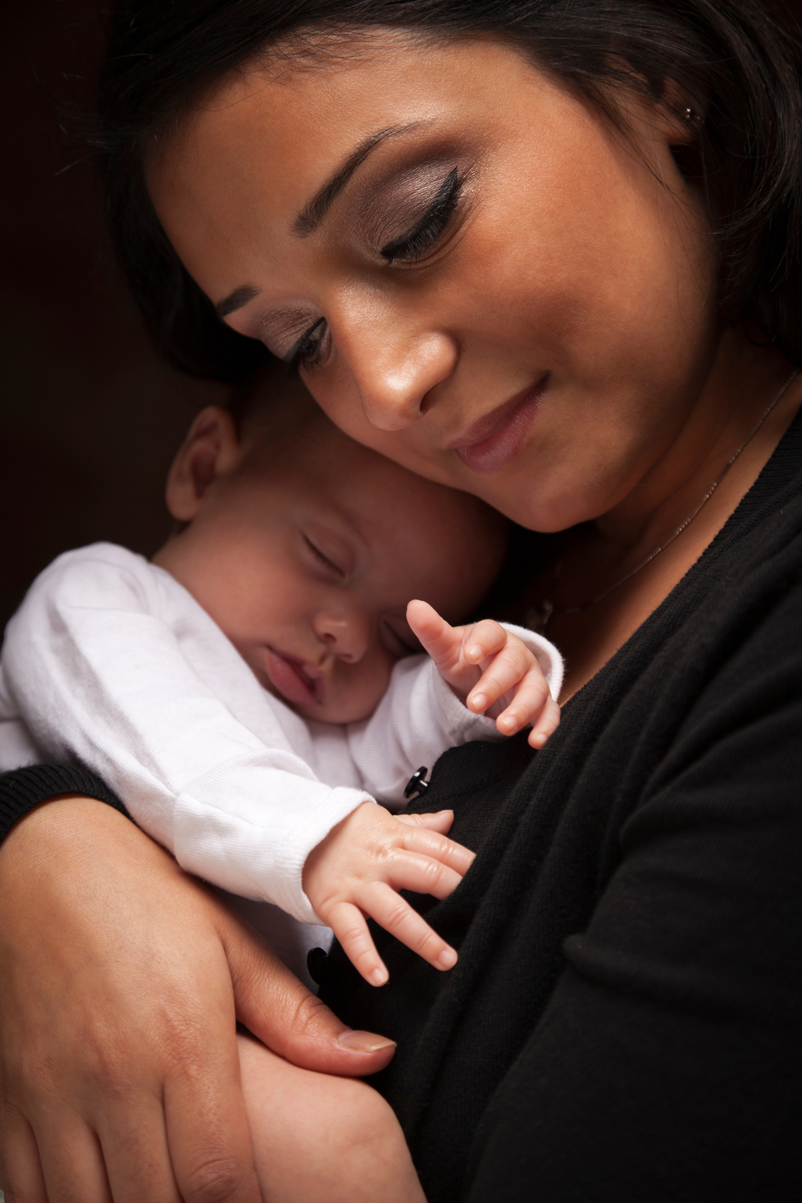

About One Parent Families Scotland
Established in 1944 - 80th anniversary year!
Providing expert advice and practical support to single parent families across Scotland.
Campaign with parents to make their voices heard to change the systems, policies and attitudes that disadvantage single parent families.

Slide 3

Local services
Policy and Research
National Debt service
National Advice and Information Helpline
Notes:
Childcare: Difficulty in affordable and flexible childcare – can lead to under employed or unemployed. School holidays – current free childcare amounts to around 30 hours per week during term time. Housing Instability: insecurity, frequent moves and living in substandard conditions. Lack of stable housing – many council have declared a housing emergency. affect children's well being and parents ability to maintain employment. Social isolation: access to services, cost of living and limited access to affordable support systems. Impacting on mental health leading to stress, anxiety and depression. Stigma – despite 1in 4 families in Scotland and 42% of marriages end in divorce there is still a lot of societal prejudice exist – stereotyping – seen as irresponsible or reliant on benefits, discrimination and

Slide 4
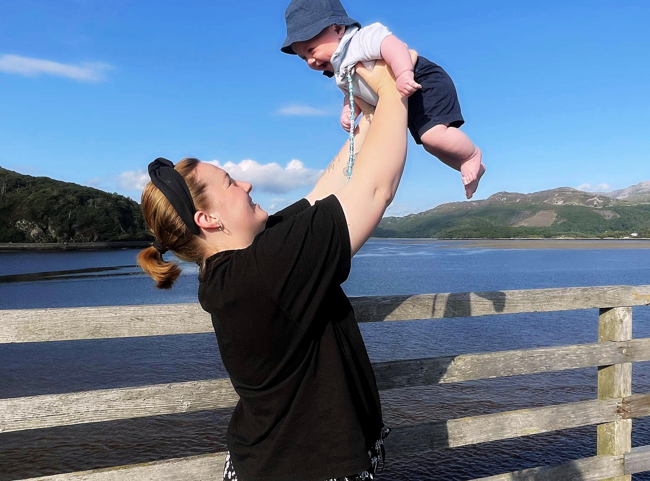


Our vision and mission
Our vision is of a Scotland where single parent families are celebrated in all their diversity, are treated fairly and live free from discrimination and poverty.
Our mission is to amplify the voices of single parents in their unique role as sole carers and care providers and together challenge stigma, poverty and inequality to achieve change.

Slide 5
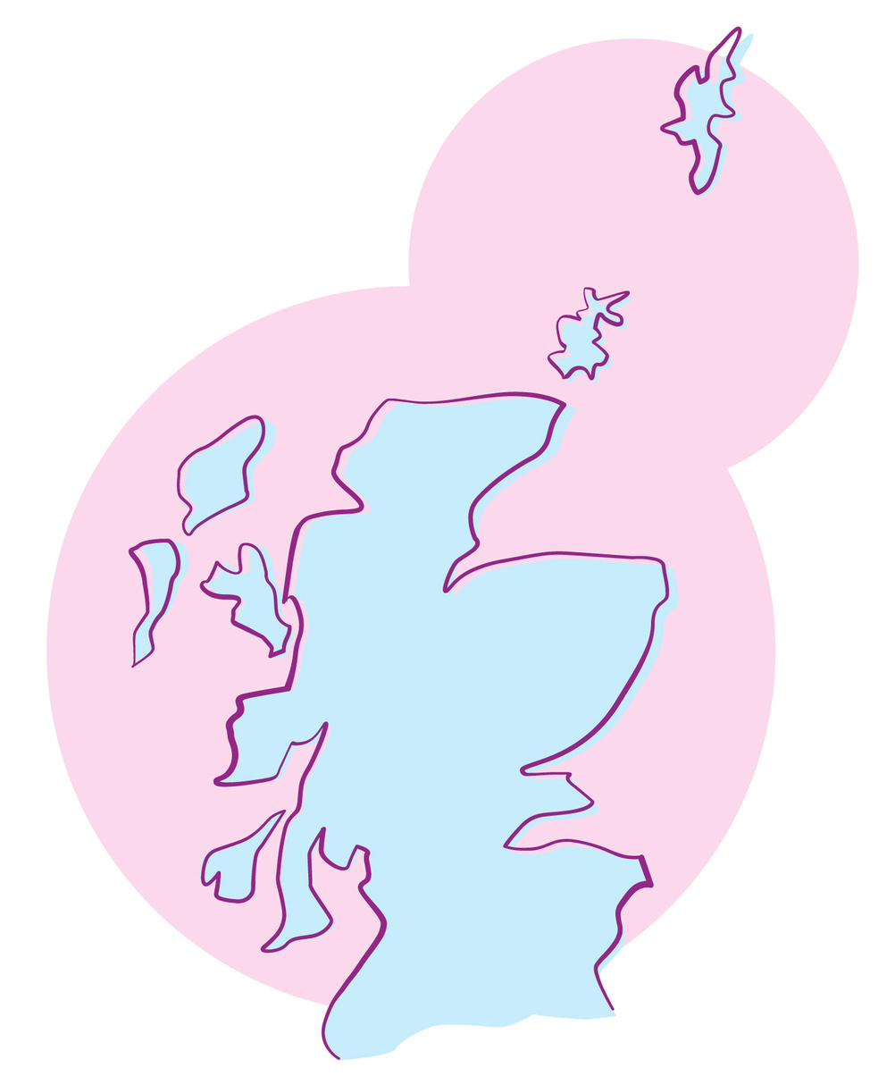
Single parents in Scotland
144,000 single parent families in Scotland
1 in 4 families in Scotland are
Single Parent Families.
80% of single parents are aged between 25 and 50
65% with dependent children
are in paid employment
Less than 1% are under 20

Slide 6
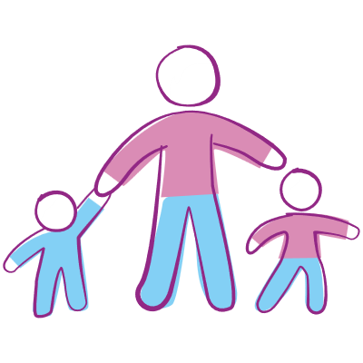
Children in single parent families
4 out of 10 children in poverty live in a single
parent household.
A quarter (23%) live in families where the parent works part-time.
40% of children in a single parent
household are also in a household with a
disabled person
·
·

Slide 7
Additional Challenges
Childcare Costs & Caring responsibilities
Housing Instability
Social Isolation
Mental Health Impact
Stigma and shame
Notes:
Childcare: Difficulty in affordable and flexible childcare – can lead to under employed or unemployed. School holidays – current free childcare amounts to around 30 hours per week during term time. Housing Instability: insecurity, frequent moves and living in substandard conditions. Lack of stable housing – many council have declared a housing emergency. affect children's well being and parents ability to maintain employment. Social isolation: access to services, cost of living and limited access to affordable support systems. Impacting on mental health leading to stress, anxiety and depression. Stigma – despite 1in 4 families in Scotland and 42% of marriages end in divorce there is still a lot of societal prejudice exist – stereotyping – seen as irresponsible or reliant on benefits, discrimination and

Slide 8
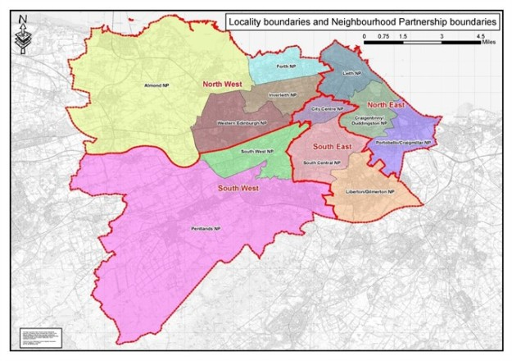
OPFS Edinburgh
Childcare Connector
Holistic Whole Family Support
Employability
OPFS Six Key Priority Areas: Money; Home; Health and Wellbeing; Work, Education, Training; Children; Relationships
Financial Health Check
Child Maintenance guidance and support
Free counselling – in person or online
Group work/summer programme
National Debt support service
National Advice and Information line
Notes:
Childcare: Difficulty in affordable and flexible childcare – can lead to under employed or unemployed. School holidays – current free childcare amounts to around 30 hours per week during term time. Housing Instability: insecurity, frequent moves and living in substandard conditions. Lack of stable housing – many council have declared a housing emergency. affect children's well being and parents ability to maintain employment. Social isolation: access to services, cost of living and limited access to affordable support systems. Impacting on mental health leading to stress, anxiety and depression. Stigma – despite 1in 4 families in Scotland and 42% of marriages end in divorce there is still a lot of societal prejudice exist – stereotyping – seen as irresponsible or reliant on benefits, discrimination and

Slide 9
Family Structure

Slide 10
Kinship Carer Case Study – Claire*
Referral & Initial Support
Claire was referred by Big Hearts Foundation for help exploring childcare options after being declined respite or a funded early years space by social work.
Home Visit & Assessment
OPFS Childcare Connector met Claire at home, introduced OPFS services, and listened to Claire’s story as a kinship carer. External support was offered but not required due to existing support from Big Hearts and a kinship worker.
Childcare Guidance
OPFS Childcare Connector provided information on childcare types, term-time vs. year-round care, and local options.
Advocacy & Practical Support
OPFS Childcare Connector attended a social work review meeting and coordinated with other support services.
Financial & Resource Assistance
Applied for a £1,500 Turn2Us grant for nursery fees
Secured a £500 OPFS grant for upfront costs
Referred family to Baby Bank
Ongoing Engagement
Claire expressed deep appreciation for the support. She continues working with OPFS and is now engaging with employability services, aiming to become self-employed and has also introduced two friends to the service who we are now supporting

Slide 11
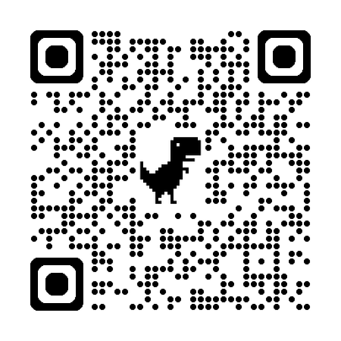
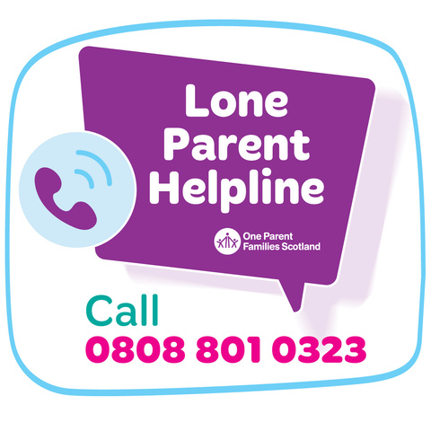

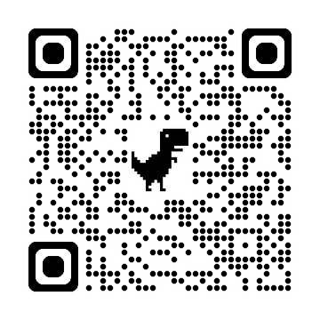

Visit our
website
Use our free helpline
& live chat service
Stay in touch!
Follow us on
social media @opfs
Sign up to our
newsletter

